Slide 1
9/30資料庫設計作業

Slide 2
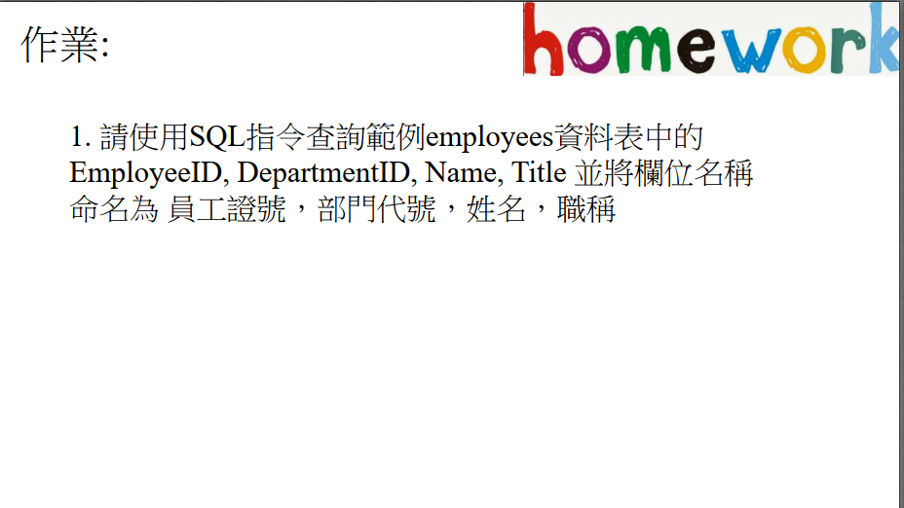

Slide 3
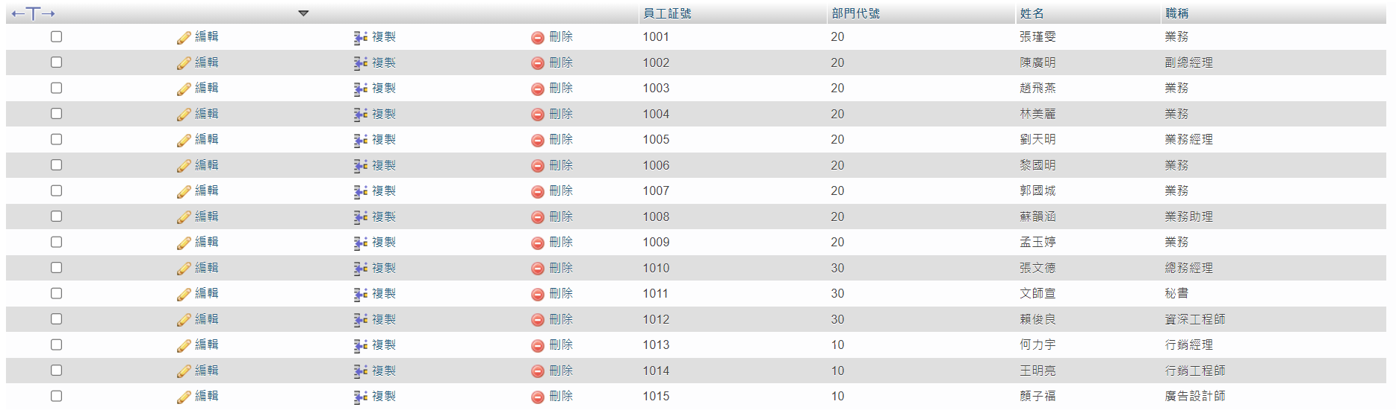
SELECT EmployeeID as 員工證號,DepartmentID as 部門代號,Name as 姓名,
Title as 職稱 FROM `employees`

Slide 4
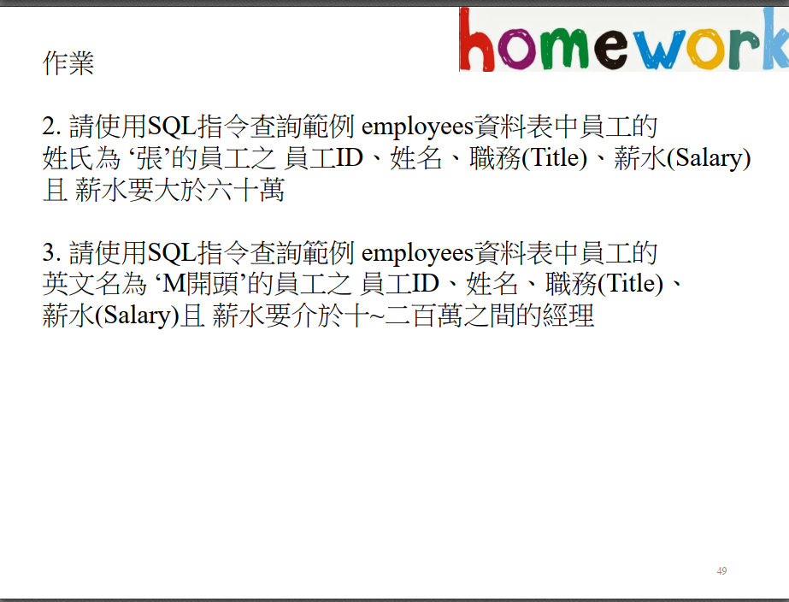

Slide 5
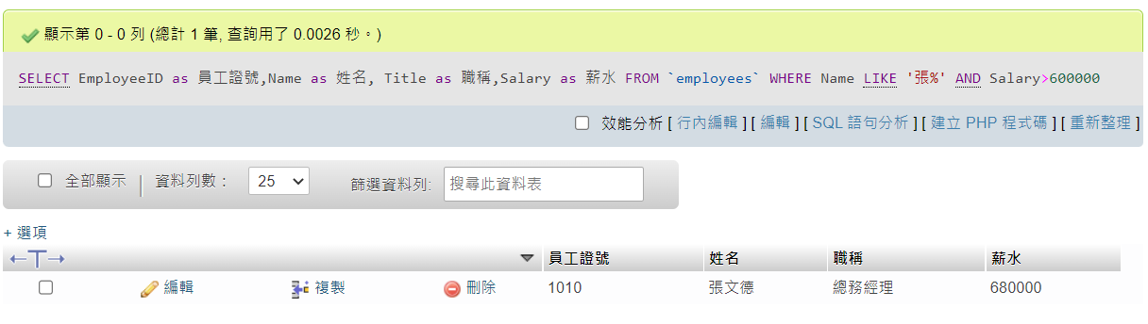
SELECT `EmployeeID` as 員工證號,`Name` as 姓名, `Title` as 職稱,
`Salary` as 薪水 FROM `employees` WHERE `Name` LIKE '張%' AND `Salary`>600000

Slide 7
3.
SELECT `EmployeeID` as 員工證號,`Name` as 姓名, `Title` as 職稱, `Salary` as 薪水 FROM `employees` WHERE EngName LIKE 'M%' AND `Salary`>=100000 and `Salary` <=2000000

Slide 8
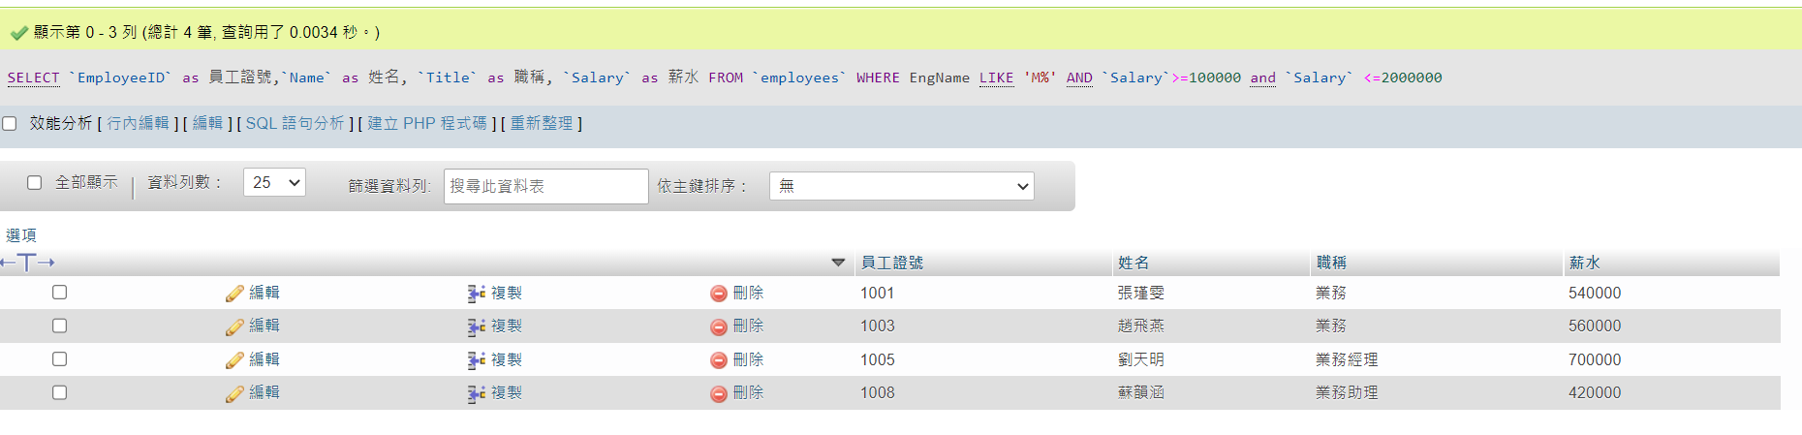
SELECT `EmployeeID` as 員工證號,`Name` as 姓名, `Title` as 職稱,
`Salary` as 薪水 FROM `employees`
WHERE EngName LIKE 'M%' AND `Salary`>=100000 and `Salary` <=2000000

Slide 9
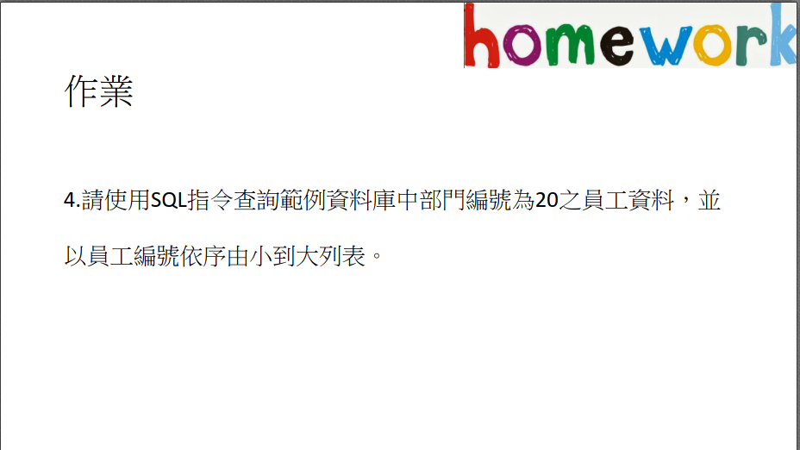

Slide 10
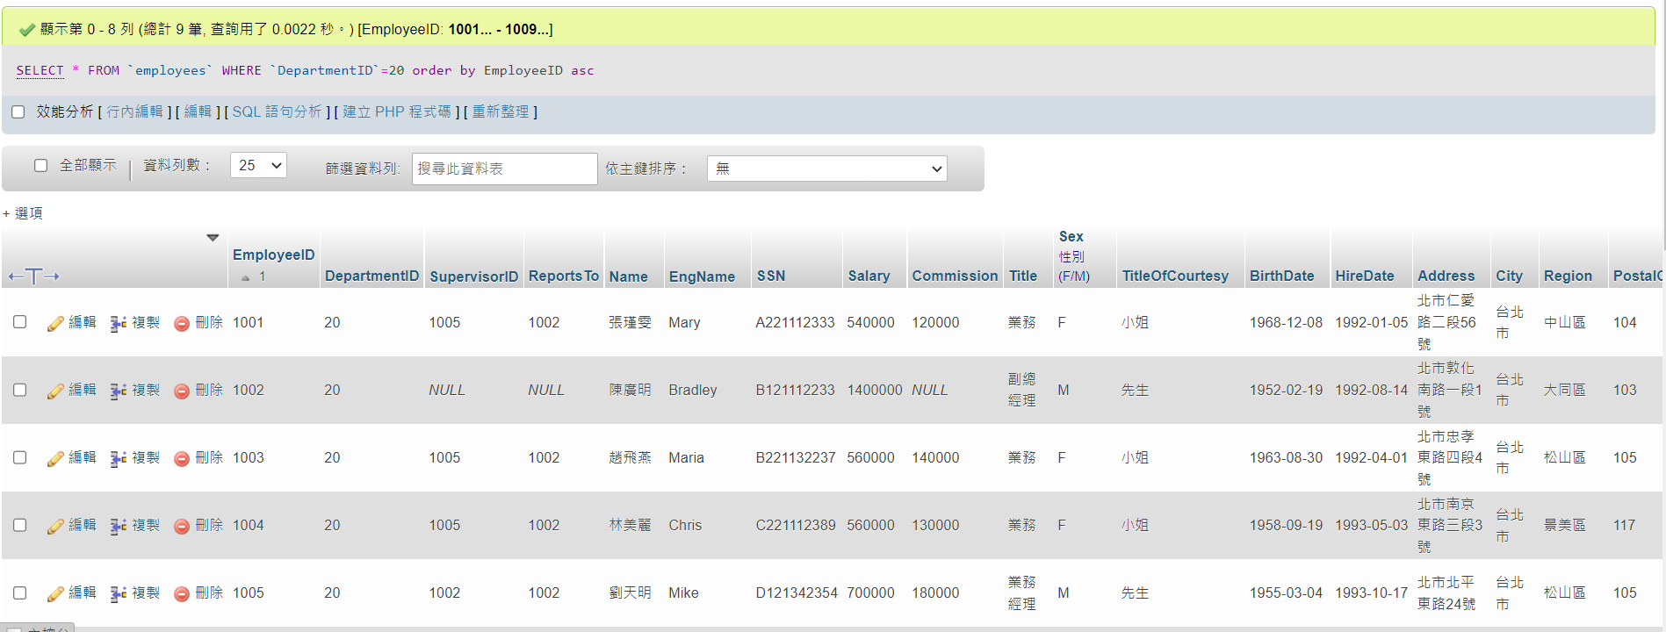
SELECT * FROM `employees` WHERE `DepartmentID`=20 order by EmployeeID asc

Slide 11
5. 請統計orders 資料庫中的職務種類及員工數且首先根據員工數大到小排序、再根據職務種類排序 (小到大)。

Slide 12
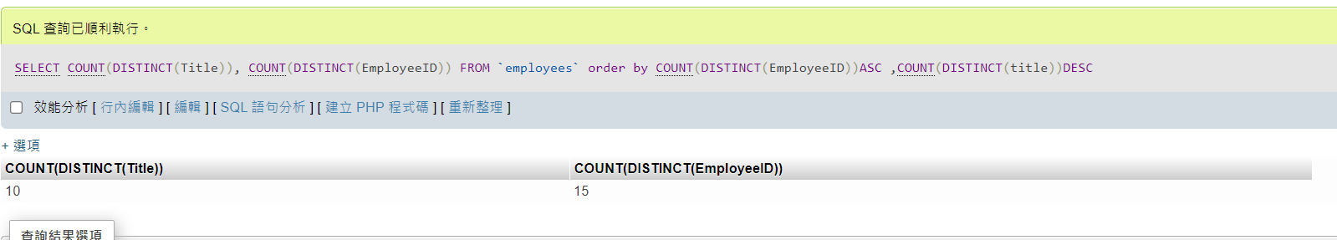
SELECT COUNT(DISTINCT(Title)), COUNT(DISTINCT(EmployeeID))
FROM `employees` order by COUNT(DISTINCT(EmployeeID))ASC ,COUNT(DISTINCT(title))DESC

Slide 13
6.
查詢員工之薪資年薪超過50萬且為業務部門20的員工之工號、姓名、年薪及雇用日期。

Slide 14
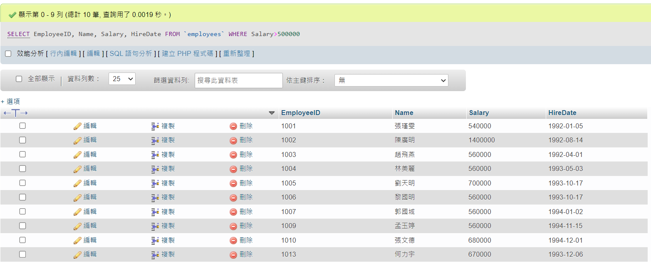
SELECT EmployeeID, Name, Salary, HireDate FROM `employees` WHERE Salary>500000

Slide 15
7.
查詢所有員工中的最高薪資資料前十名之員工資料。

Slide 16
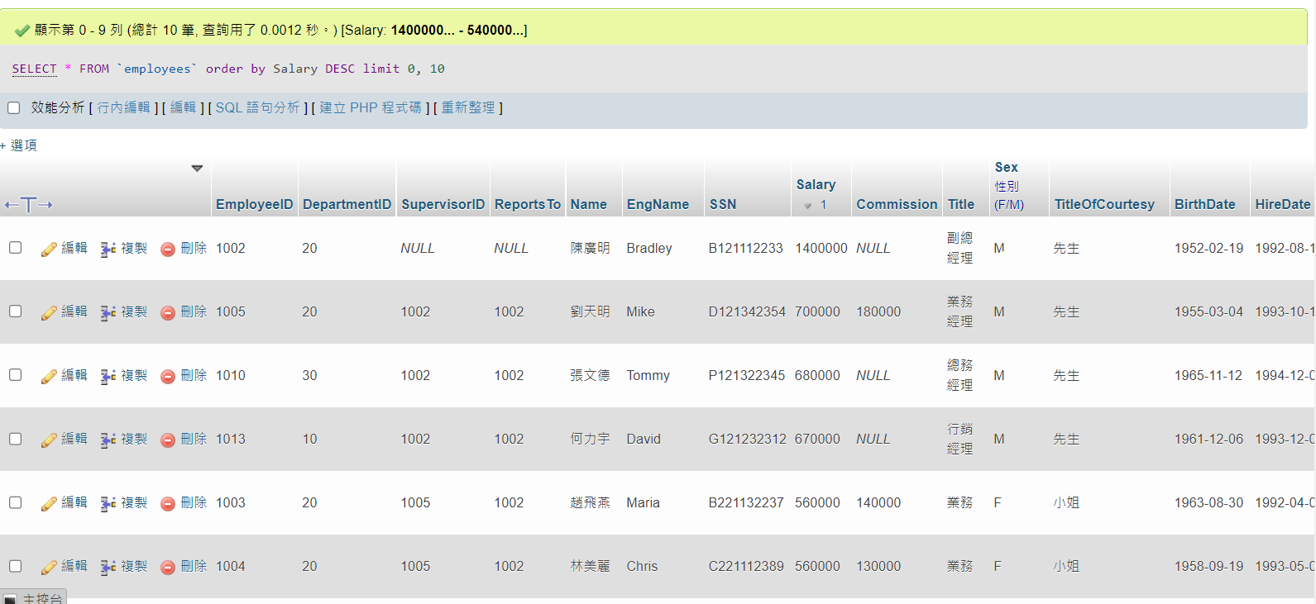
SELECT * FROM `employees` order by Salary DESC limit 0, 10

Slide 17
8.
請依部門統計員工之平均薪資(欄位別名 AVG)、最小(欄位別名 MIN)及最高(欄位別名 MAX)薪資。

Slide 18
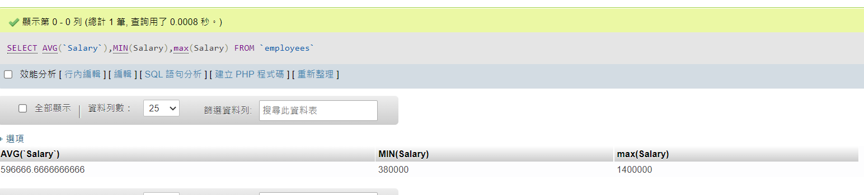
SELECT AVG(`Salary`),MIN(Salary),max(Salary) FROM `employees`

Slide 19
9.
查詢薪資介於50～70萬的男性員工之部門、員工號、姓名、薪資及職務

Slide 20
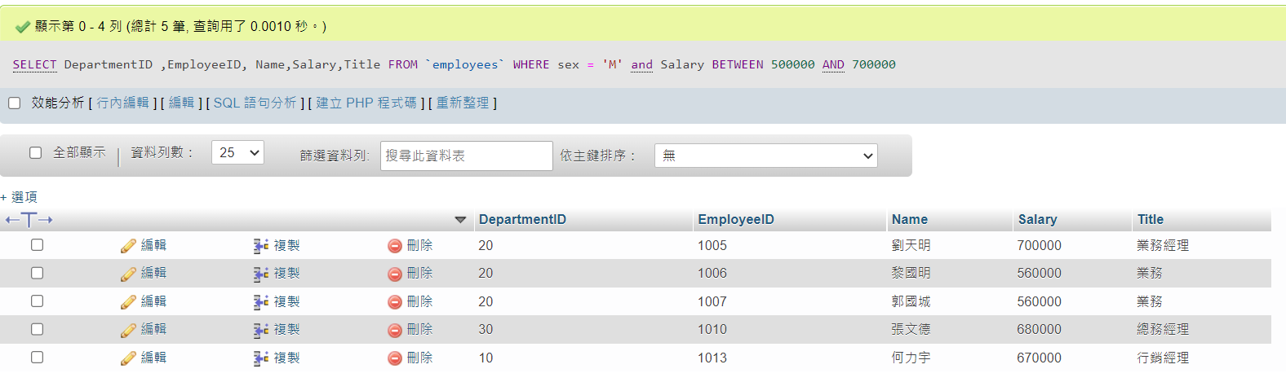
SELECT DepartmentID ,EmployeeID, Name,Salary,Title FROM `employees` WHERE sex = 'M' and Salary BETWEEN 500000 AND 700000

Slide 21
10.
查詢範例資料庫中職務非管理階層(不是經理)的員工之資料，佣金(Commission)不為NULL，並以員工號依序由小到大排序

Slide 22
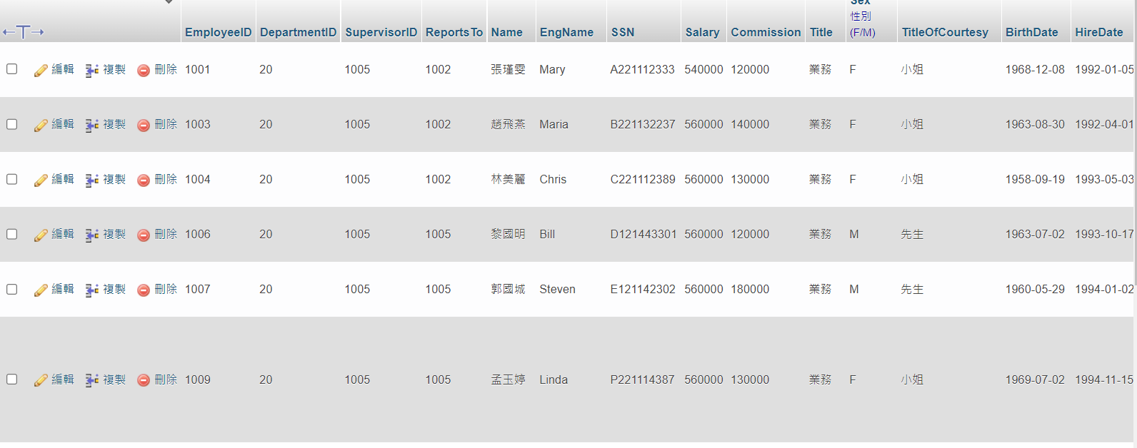
SELECT * FROM `employees` WHERE `title` not like '%經理' AND Commission IS NOT NULL

